Slide 1
Orphanage Automated Records System
Project by Victor Oshiomah
Dec 2022
Coordinated by Professor Abe Kazemzadeh
University of St. Thomas, MN

Slide 2
Introduction
With this project, my focus was building an automated records system for dreams from the slum orphanage home located in Lagos State, Nigeria to help manage information about orphans, donors, volunteers, and the home. However, this database can be replicated and used for any other orphanage home.
Having volunteered with this home and seen the amount of time spent on paperwork, I have always wanted to create a proper records system to ease the work of the management. I believe that with an efficient automated records system, staff of the home would spend less time on paperwork and devote more time to building personal relationships with these orphans.

Slide 3
MVP vs Ambitious goal
MVP
As a newbie to database management, my minimum viable product was a database that manages the relationship between main entities – ORPHANS, DONOR, VOLUNTEERS, STAFF and DEPARTMENTS. The idea was to help the orphanage home manage the records of each orphan and their corresponding donors, volunteers and staff, and their corresponding departments. However, I realized I could do more, so I aimed for my ambitious goal.
Ambitious Goal
Build the MVP and include entities- ALUMNI (adopted orphans) and ADOPTIVE_PARENTS.

Slide 4
Topics I explored

Slide 5
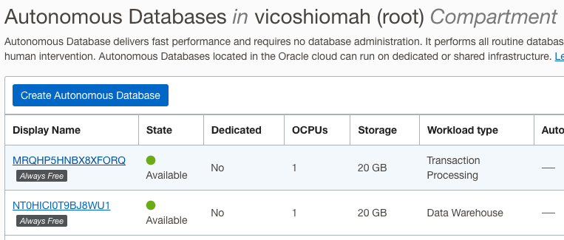
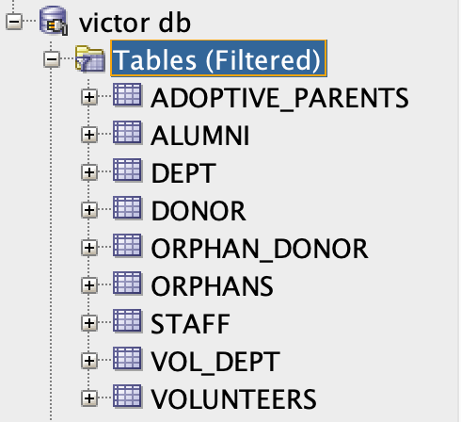
1. Setting up a database on Oracle Cloud/SQL Developer:
I explored using oracle cloud to create an autonomous database, and I successfully linked it to SQL Developer using the wallet I generated. I did this because I had difficulties with exporting the DDL statements from Live SQL. After installing my database on SQL Developer, I re-ran the queries and successfully generated my DDL statements. I also ran my DML queries in SQL Developer to save me the hassle of running session scripts on Live SQL every time I logged in.

Slide 6
2. Data Definition Language (DDL)
I have created tables for the 5 entities required for the MVP and 2 extra entities from my ambitious goal using create table statements as learned from this course. The tables were created on SQL Developer. I ensured that primary, and foreign key constraints were properly assigned using commands like ALTER to make changes to the structure of the database. I also used DROP statements to drop tables where they needed to be dropped. Here are the DDL statements for this database.

Slide 7
3. Data Manipulation Language (DmL)
I have populated the tables with some data using insert statements on SQL Developer. The insert statements follow the sequence taught in this course. The DML statements also highlighted the different data types learnt from this course. I also used UPDATE statements to make changes to the data within the tables. Here are the DML statements for this database.

Slide 8
4. Entity Relationship Diagram
I used this to show the relationship between entities and the inherent cardinalities. I did reverse engineering on Oracle Data Modeler using the DDL statements from Live SQL to create the logical model and ensure it has the correct attributes. I used reverse engineering on Oracle Data Modeler to create the logical model from the DDL statements, made updates to the attributes, and mapped out the cardinalities. I then forward-engineered the updated logical model to generate a more accurate relational model with intersection tables. See the image of relational model in next slide.

Slide 9
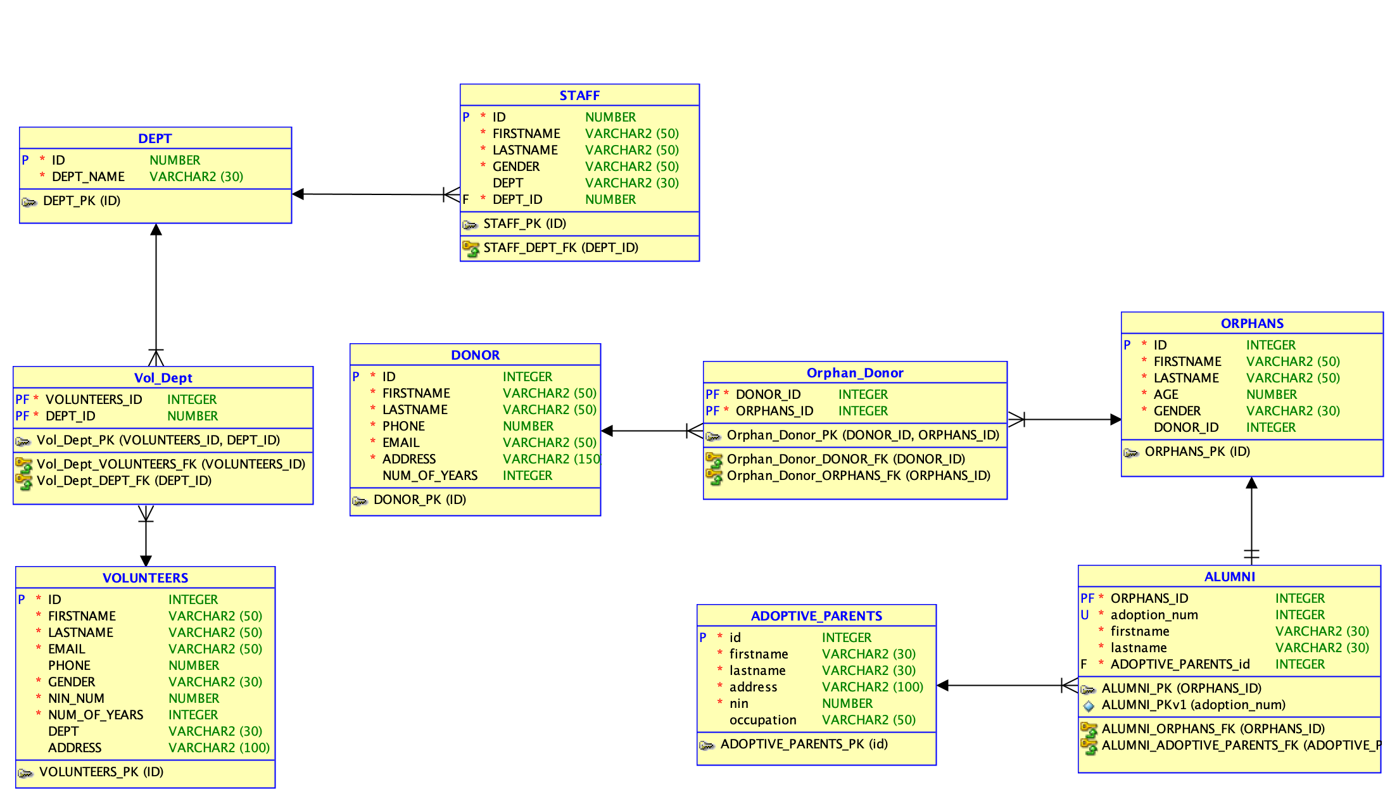
ER DIAGRAM

Slide 10
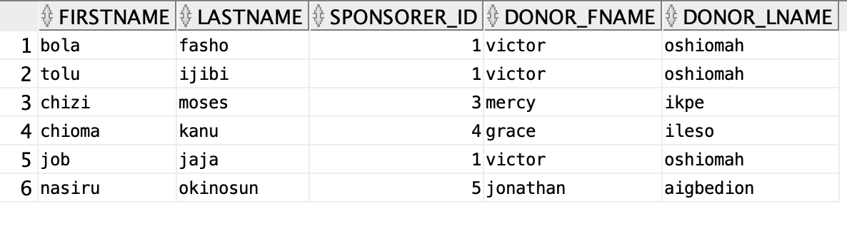
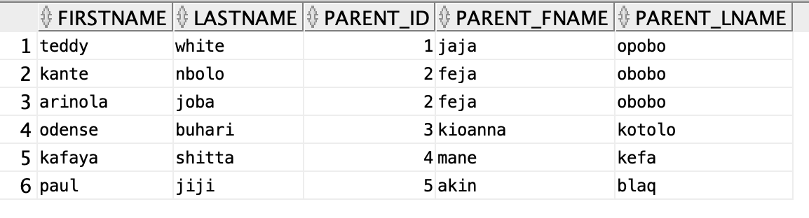
5. SQL ViEW
Orphans and Their Donor View
I used the knowledge of creating a views to create a table that shows each child (orphan) and their corresponding donor. I also to create a view to show adopted orphans (alumni) and their adopted parents.
Adopted Orphans and Their Adopted Parents View

Slide 11
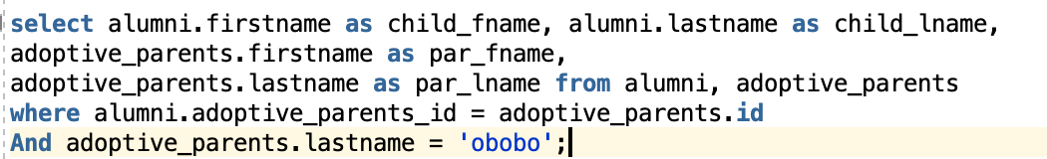
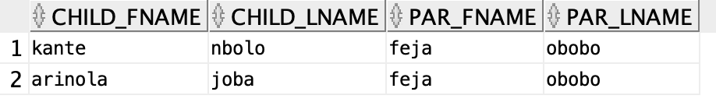
6. SQL Join syntax
I used an explicit join to create the table used in the views. With this syntax, I was also able to create aliases for existing columns.
7. Data Query Language (DQL)
I used SELECT statements to retrieve data about the entities as I worked on this database. The example below shows children that have been adopted by feja obobo.

Slide 12
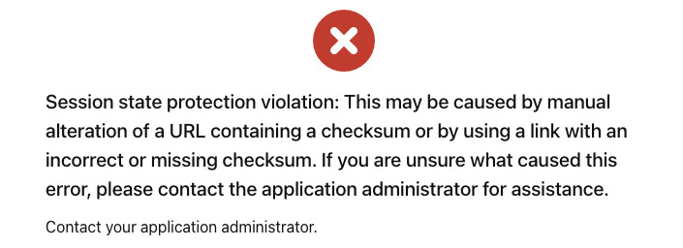
CHALLENGES
Exporting DDL from Live SQL
I encountered issues with downloading DDL statements from SQL. When I tried to, it showed the error message in the image below. To resolve this, I created my own autonomous database in oracle cloud and linked it to SQL developer. I then ran my DDL queries on SQL Developer to create the entities.
Creating After Insert Triggers
Even though this wasn’t a part of my MVP, I had an ambitious goal of creating a trigger that would update the Alumni table with adopted child info as soon an adoptive parent id is entered on the orphan table. My attempts so far haven't yielded the desired result, so as one of my next steps, I’m going to work on ensuring I create a trigger. Details of the code and errors I was getting are in my final project write-up, part 4.

Slide 13
conclusion
This would not be the end of this project for me as I intend to build on it with future classes from my graduate program in software. At the beginning of this class, I was a complete newbie to database design and management, and I knew next to nothing about it. Looking at what I have done with this project, I believe that I am some miles ahead of where I was at the beginning of this class.
This project particularly has helped me gain more knowledge of creating basic database systems and the functionalities that can be explored, and I’m quite happy about my progress. I have found that creating the tables and inserting values myself on Live SQL and SQL Developer made it easier for me to understand what I was doing. Overall, I have tried to make use of all the tools (Live SQL, Oracle Cloud, SQL Developer, Oracle Data Modeler) I learnt about on this project, so that I can get a good grasp of how their functionalities.
I was able to achieve my MVP and build 70% of my ambitious goal as well. With an AFTER-INSERT trigger on the Orphan entity, I should have also completed my ambitious goal.
I haven't been able to overcome the problem I encountered with creating an AFTER-INSERT TRIGGER, but I'm fully motivated to do so as a part of my next steps.

Slide 14
NEXT STEPS
Create a trigger that would update the Alumni table based adopted child info as soon an adoptive parent id is entered on the orphan table.
As recommended by my colleagues in this class, build a front-end interface for the database using Oracle Apex.
And a class entity for the classes that each orphan is taking in the home.

